Slide 1


Expository Writing
The “How and Why” of Writing
source: http://bomedia3.pbworks.com/f/Expository%20Essay%20Powerpoint%20(2).ppt

Slide 2
What is Expository Writing?
Expository writing is defined as presenting reasons, explanations, or steps in a process
Informational writing
An expository essay should follow a logical sequence and have three different main points
Logic and coherence is the main focus of an expository essay

Slide 3
How is it different ?
Expository writing does not tell a story
Expository writing does not persuade a reader but only gives facts and reasons
Expository writing can also give the steps of a process

Slide 4
WHAT IS AN EXPOSITORY ESSAY?
An EXPOSITORY essay is a multi-paragraph essay with a specific structure.
It explains a position or opinion that you have regarding a topic or text.
It provides adequate textual evidence to support that opinion.
AN EXPOSITORY ESSAY IS NOT …
It is not a summary of the book.
It is not a book review or a book report.
It is not ONLY your opinion. You must base your ideas on events from the text.

Slide 5
FORMAT OF AN EXPOSITORY ESSAY
An EXPOSITORY essay contains ____ paragraphs.
All paragraphs have a name:
1st Paragraph(s) : Introductory Paragraph(s)
Paragraph #2, 3, 4 etc.: Body Paragraphs
Final Paragraph(s): Concluding Paragraph(s)

Slide 6

Topic Sentences, Thesis Statements, and Subtopic are the Heart
Thesis: a statement discussing the topic of your paper.
Main Ideas: the main ideas that support your thesis.
Topic Sentences: a statement that discusses the topic of each paragraph.

Slide 7

Definition of Terms
Thesis Statement: The main idea of the whole essay
Transition words: Words such as first, second, as a result, which make transitions easy in the essay.
Main Ideas: Each paragraph should have a main point or idea
Supporting Details: Details support the main ideas

Slide 8
Introductory Paragraph
Body Paragraphs = Main Ideas that support your Thesis Statement
Concluding Paragraph

Slide 9
Expository Writing (cont.)
Introduction of an expository should include the what the essay is about and the Thesis Statement
The three main reasons supporting this main idea should also be included in the introduction

Slide 10
Thesis Statement
The thesis statement is usually the last sentence in the introductory paragraph. It tells explicitly what points will be made in the essay.

Slide 11
Sample Thesis Points
The Grand Canyon was a great place to visit because of the spectacular views, the challenging hike to the top, and the time we had to bond as a family.

Slide 12
Thesis
Although my family and I have taken many vacations, none was more exciting than a trip to the Grand Canyon.

Slide 13
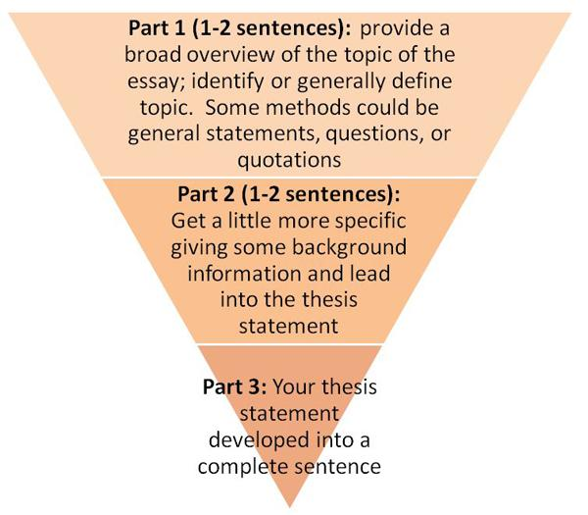
Introductory Paragraph – Inverted Pyramid

Slide 14
Introduction
Hook- Hook your reader with a question, quote, short anecdote, or personal experience statement

Slide 15
Ways to Develop a Good Hook
1. Use an Anecdote/ Scenario
The writer provides a personal experience or made-up situation to introduce the position.
2. Questioning
The writer asks thought-provoking questions to capture the reader’s interest.
3. Interesting fact or statistic
The writer gives an interesting piece of information to grab the reader’s attention.

Slide 16
Body Paragraphs
Purpose of Body Paragraphs:
To support your topic statement using direct quotations, specific textual detail, and strong explanations.
Elements of a Body Paragraph:
Topic Sentence
Textual Evidence
Explanation of Evidence
Concluding/ Transition Sentence

Slide 17
VOCABULARY OF BODY PARAGRAPHS
TOPIC SENTENCE
The first sentence in each body paragraph. It gives the reader specific information about what will be explained in the body paragraph. It is best to use words from the TOPIC STATEMENT in this sentence.
TEXTUAL EVIDENCE
Sentences in the body paragraph which use the AUTHOR’S EXACT WORDS to help support your topic statement.
EXPLANATION OF EVIDENCE
Sentences in the body paragraph which explain to the reader HOW YOUR TEXTUAL EVIDENCE SUPPORTS YOUR TOPIC STATEMENT.

Slide 18
Expository writing contd.
Paragraph two should introduce the first reason and give details to support the first reason
Paragraph three should introduce the second reason and give details to support the second reason
Paragraph four should introduce the third reason and give details to support the third reason
The conclusion should re-state all the reasons

Slide 19
Body Paragraph
Topic Sentence
Textual Evidence
Explanation of Evidence
(repeat for each piece of textual evidence)
Concluding Sentence

Slide 20

Evidence and Examples
Your evidence is the meat of the essay. You need to prove what you know.
Remember the Es:
-Examples
-Explanations
-Evidence
-Elaboration

Slide 21

Addressing the Bias
Addressing the Bias is a term for persuasive writing. Bias is the pre-judgment a person has on a topic.
For expository writing, addressing the bias means clarifying any misunderstandings that readers may have:
“Just to be clear, this means_____________________________________, which is not to be confused with __________________________________________.”

Slide 22

Transitions
Like shifting from one gear to the next in a car, a transition shifts from one paragraph to the next. It is the glue of an essay.

Slide 23

Transition words
Add your transition words
First
Second
Third
Finally, or In Conclusion

Slide 24

Conclusion
Conclusions restate your thesis and the main ideas that support your thesis
remind your reader what you wrote about.
Do not include any new information in your conclusion.

Slide 25
CONCLUDING PARAGRAPH
Purpose of Concluding Paragraph
To summarize your main ideas for your reader, so they leave your writing with clarity.
Elements of Concluding Paragraph
Restate your topic statement
Review body paragraphs

Slide 26
Concluding Paragraph
Restate Thesis
Review Paragraph Ideas

Slide 27
Re-Cap: Expository writing needs:
One topic
Reasons supporting that topic
Details supporting the reasons
A conclusion re-stating the reasons
Transition words
Clear, concise, logical and informative language

Slide 28
Outlining an Expository Essay
Use an outline to organize your essay
Preplanning ensures you don’t forget anything.
Essay practically writes itself from the outline.

Slide 29
Editing your essay
Check that you have all the elements of an expository essay:
Reasons
Details
Transition words
Conclusion that re-states your topic
Grammar
Coherence, logic and clearly written

